Slide 1
Project 4
Mary, Jess, Sarah, Galen

Slide 2
Overview
Project Objective: | Investigate factors driving house prices in Ames, Iowa
Data: | Kaggle dataset for Ames Housing
Methods: | Analysis Tableau analysis Cluster analysis Machine Learning price prediction model Tech Host data on S3 Model in Colab Develop

Slide 3
Results – Data Visualization
Screenshots of top 3 findings here

Slide 4
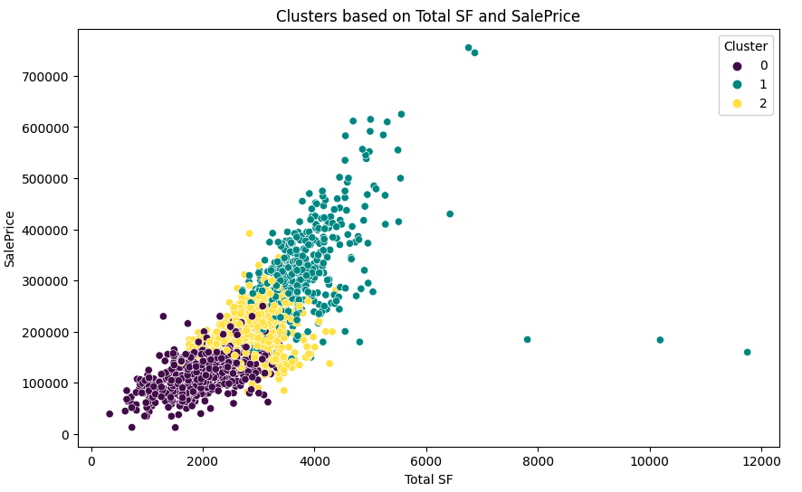
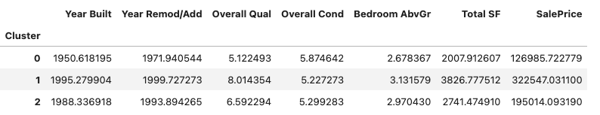
Results - Clustering
Screenshots of clusters here
2-3 plots of the clusters based on different variables
Table with the clusters and key summary stats for each (see example below)
Top things that correlate with price, and what composes that thing (ex: quality is highly correlated, so what correlates with quality: this tells us something about what “quality” means to the market”)

Slide 5
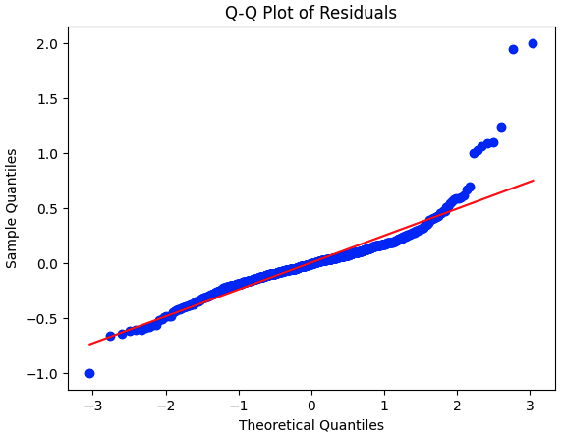
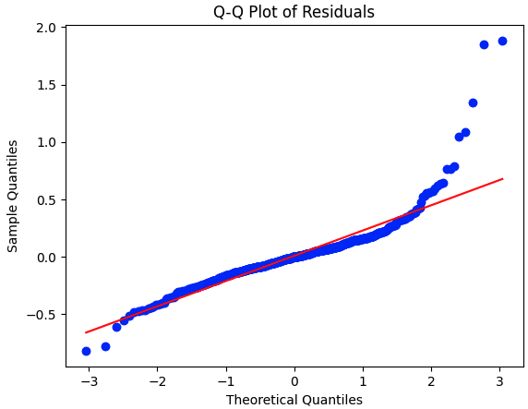
Results - Modeling
Trained Linear Regression & XG Boost
Q-Q plots suggest there is an interaction or variable not accounted for in the model; overall good fit
Linear Regression was powerful out of the box, more complex models only gave marginal gains
Linear Regression
XG Boost
Training R-Squared: 0.9401
Testing R-Squared: 0.9397
Mean Squared Error: 0.0695
Best Parameters: {'learning_rate': 0.1, 'loss': 'huber', 'max_depth': 3, 'n_estimators': 200, 'subsample': 1.0}
Training R-Squared: 0.9676501961674518
Testing R-Squared: 0.9501703258657423
Mean Squared Error: 0.05743137013095087

Slide 6
Demo Time
Predictions Webpage
Report Webpage

